Slide 1
Cache Memory

Slide 2
LOCALITY
PRINCIPAL OF LOCALITY is the tendency to reference data items that are near other recently referenced data items, or that were recently referenced themselves.
TEMPORAL LOCALITY : memory location that is referenced once is likely to be referenced multiple times in near future.
SPATIAL LOCALITY : memory location that is referenced once, then the program is likely to be referenced at a nearby memory location in near future.

Slide 3
CACHE MEMORY
Principle of locality helped to speed up main memory access by introducing small fast memories known as CACHE MEMORIES that hold blocks of the most recently referenced instructions and data items.
Cache is a small fast storage device that holds the operands and instructions most likely to be used by the CPU.

Slide 4
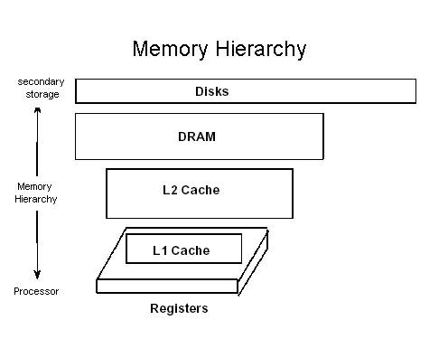
Memory Hierarchy of early computers: 3 levels
CPU registers
DRAM Memory
Disk storage

Slide 5
Due to increasing gap between CPU and main Memory, small SRAM memory called L1 cache inserted.
L1 caches can be accessed almost as fast as the registers, typically in 1 or 2 clock cycle.
Due to even more increasing gap between CPU and main memory, Additional cache: L2 cache inserted between L1 cache and main memory : accessed in fewer clock cycles.

Slide 6
L2 cache attached to the memory bus or to its own cache bus.
Some high performance systems also include additional L3 cache which sits between L2 and main memory. It has different arrangement but principle same.
The cache is placed both physically closer and logically closer to the CPU than the main memory.

Slide 7
CACHE LINES / BLOCKS
Cache memory is subdivided into cache lines
Cache Lines / Blocks: The smallest unit of memory that can be transferred between the main memory and the cache.

Slide 8
Example:
Memory segments and cache segments are exactly of the same size. Every memory segment contains equally sized N memory lines. Memory lines and cache lines are exactly of the same size. Therefore, to obtain an address of a memory line, it needs to determine the number of its memory segment first and the number of the memory line inside of that segment second, then to merge both numbers. Substitute the segment number with the tag and the line number with the index, and you should have realized the idea in general.

Slide 9
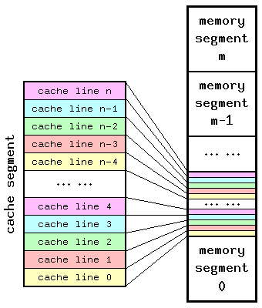

Slide 10

Therefore, cache line's tag size depends on 3 factors:
Size of cache memory;
Associativity of cache memory;
Cacheable range of operating memory.
Here,
S_{tag} — size of cache tag, in bits;
S_{memory} — cacheable range of operating memory, in bytes;
S_{cache} — size of cache memory, in bytes;
A — associativity of cache memory, in ways.

Slide 11
TAG / INDEX
Every address field consists of two primary parts: a dynamic (tag) which contains the higher address bits, and a static (index) which contains the lower address bits.
The first one may be modified during run-time while the second one is fixed.

Slide 12
VALID BIT / DIRTY BIT
When a program is first loaded into main memory, the cache is cleared, and so while a program is executing, a valid bit is needed to indicate whether or not the slot holds a line that belongs to the program being executed.
There is also a dirty bit that keeps track of whether or not a line has been modified while it is in the cache. A slot that is modified must be written back to the main memory before the slot is reused for another line.

Slide 13
CACHE HITS / MISSES
Cache Hit: a request to read from memory, which can satisfy from the cache without using the main memory.
Cache Miss: A request to read from memory, which cannot be satisfied from the cache, for which the main memory has to be consulted.

Slide 14
CACHE MEMORY : MAPPINGS
There are three commonly used methods to translate main memory addresses to cache memory addresses.
Associative Mapped Cache
Direct-Mapped Cache
Set-Associative Mapped Cache
The choice of cache mapping scheme affects cost and performance, and there is no single best method that is appropriate for all situations

Slide 15
CACHE MEMORY : MAPPINGS
In the discussion of these three mapping techniques we will use a specific example of a memory organization as shown in following figure.
The main memory can store 32K words (32K = 2⁵ × 2¹⁰ = 2¹⁵, so address bit = 15) of 12 bits each. The cache is capable of storing 512 of these words at any given time.
For every word in cache there is a duplicate copy in main memory.
The CPU first sends 15 bits address to the cache. If there is a hit, CPU accepts 12 bit data from the cache.
If there is a miss, the CPU reads word from main memory and the word is then transferred to cache memory.

Slide 16
Associative Mapping
A block in the Main Memory can be mapped to any block in the Cache Memory available (not already occupied).
Advantage: Flexibility. An Main Memory block can be mapped anywhere in Cache Memory.
Disadvantage: Slow or expensive. A search through all the Cache Memory blocks is needed to check whether the address can be matched to any of the tags.

Slide 17
Direct Mapping
To avoid the search through all CM blocks needed by associative mapping, this method only allows to map each block of main memory into only one possible cache line.
In general there are 2^{n} words in main memory and 2^{k} words in cache memory.
The n bit address is divided into two parts, k bits for index and n – k bits for the tag.

Slide 18
Advantage: Direct mapping is faster than the associative mapping as it avoids searching through all the CM tags for a match.
Disadvantage: But it lacks mapping flexibility. For example, if two MM blocks mapped to same CM block are needed repeatedly (e.g., in a loop), they will keep replacing each other, even though all other CM blocks may be available.

Slide 19
Set-Associative Mapping
This is a trade-off between associative and direct mappings where each address is mapped to a certain set of cache locations.
The cache is broken into sets where each set contains "N" cache lines, let's say 4. Then, each memory address is assigned a set, and can be cached in any one of those 4 locations within the set that it is assigned to. In other words, within each set the cache is associative, and thus the name.

Slide 20
DIFFERENCE BETWEEN LINES, SETS AND BLOCKS
In direct-mapped caches, sets and lines are equivalent. However in associative mapping caches, sets and lines are very different things and the terms cannot be interchanged.

Slide 21
BLOCK: fixed sized packet of information that moves back and forth between a cache and main memory.
LINE: container in a cache that stores a block as well as other information such as the valid bit and tag bits.
SET: collection of one or more lines. Sets in direct-mapped caches consist of a single line. Set in fully associative and set associative caches consists of multiple lines.

Slide 22
ASSOCIATIVITY
Associativity : N-way set associative cache memory means that information stored at some address in operating memory could be placed (cached) in N locations (lines) of this cache memory.
The basic principle of logical segmentation says that there is only one line within any particular segment to be capable of caching information located at some memory address.

Slide 23
REPLACEMENT ALGORITHM
Optimal Replacement: replace the block which is no longer needed in the future. If all blocks currently in Cache Memory will be used again, replace the one which will not be used in the future for the longest time.
Random selection: replace a randomly selected block among all blocks currently in Cache Memory.

Slide 24
FIFO (first-in first-out): replace the block that has been in Cache Memory for the longest time.
LRU (Least recently used): replace the block in Cache Memory that has not been used for the longest time.
LFU (Least frequently used): replace the block in Cache Memory that has been used for the least number of times.

Slide 25
The optimal replacement is the best but is not realistic because when a block will be needed in the future is usually not known ahead of time.
The LRU is suboptimal based on the temporal locality of reference, i.e., memory items that are recently referenced are more likely to be referenced soon than those which have not been referenced for a longer time.
FIFO is not necessarily consistent with LRU therefore is usually not as good.
The random selection, surprisingly, is not necessarily bad.

Slide 26

HIT RATIO and EFFECTIVE ACCESS TIMES
Hit Ratio : The fraction of all memory reads which are satisfied from the cache

Slide 27
LOAD-THROUGH STORE-THROUGH
Load-Through : When the CPU needs to read a word from the memory, the block containing the word is brought from MM to CM, while at the same time the word is forwarded to the CPU.
Store-Through : If store-through is used, a word to be stored from CPU to memory is written to both CM (if the word is in there) and MM. By doing so, a CM block to be replaced can be overwritten by an in-coming block without being saved to MM.

Slide 28
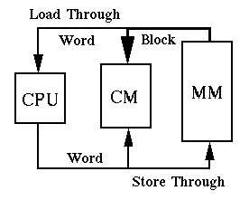

Slide 29
WRITE METHODS
Note: Words in a cache have been viewed simply as copies of words from main memory that are read from the cache to provide faster access. However this view point changes.
There are 3 possible write actions:
Write the result into the main memory
Write the result into the cache
Write the result into both main memory and cache memory

Slide 30
Write Through: A cache architecture in which data is written to main memory at the same time as it is cached.
Write Back / Copy Back: CPU performs write only to the cache in case of a cache hit. If there is a cache miss, CPU performs a write to main memory.

Slide 31
When the cache is missed :
Write Allocate: loads the memory block into cache and updates the cache block
No-Write allocation: this bypasses the cache and writes the word directly into the memory.

Slide 32
